Slide 1
A Mathematical Theory of Communication
C. E. Shannon (1948)

Slide 2
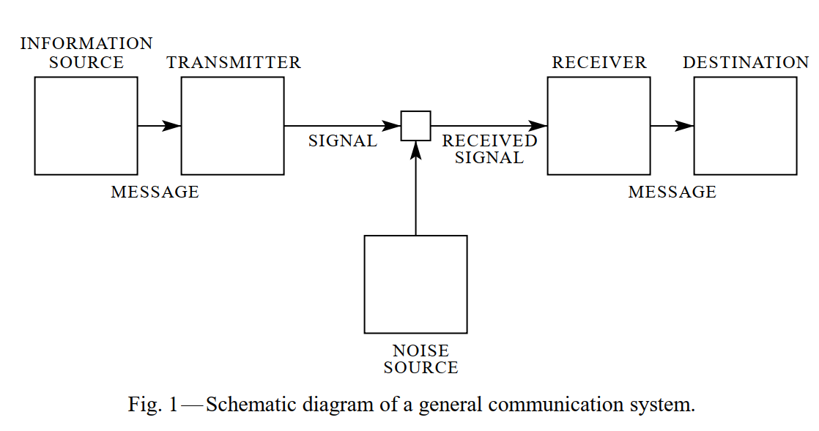
Communication System
Objective of Communication
"[...] reproducing at one point either exactly or approximately a message selected at another point."
Notes:
Various elements as mathematical entities
transmitter: construction of signal (domain change (pressure -> electrical current), sampling, compression, quantization, encoding)
receiver: inverse operation of transmitter -> reconstruct message

Slide 3
0 Introduction
Select a message from a set of possible messages
Selecting a message “produces information“
à Relation to the number of possible selections or a monotonic function of it
Logarithmic base proposed by Hartley
Intuitive
Useful in engineering and mathematics
log₁₀(N) → hartley / ban / decimal digit / dit
log₂(N) → binary digit / bit

Slide 5

1 The Discrete Noiseless Channel
Finite set of elementary symbols $S_{1}, …, S_{n}$ → discrete
Each symbol $S_{i}$ has an (individual) duration $t_{i}$
What is the capacity of such a system?
Information transmission rate is measured by $\frac{\log{N\left(T\right)}}{T}$
Number of possible sequences with duration T:
$$N\left(t\right)=N\left(t−t_{1}\right)+N\left(t−t_{2​}\right)+…+N\left(t−t_{n}​\right)$$

Slide 6

Simple example
Alphabet of 2 Symbols:
$S_{1}$​ with duration$t_{1}=1$
​$S_{2}$ with duration $t_{2}=2$
$N\left(t\right)=N\left(t−t_{1}\right)+N\left(t−t_{2​}\right)$
Empty sequence at t=0 → ; undefined at t<0
$N\left(1\right)=N\left(1−1\right)+N\left(1−2\right)=N\left(0\right)+N\left(−1\right)=1+0=1$ → $S_{1}$
$N\left(2\right)=N\left(2−1\right)+N\left(2−2\right)=N\left(1\right)+N\left(0\right)=1+1=2$ → $S_{1}S_{1}, S_{2}$
$N\left(3\right)=N\left(3−1\right)+N\left(3−2\right)=N\left(2\right)+N\left(1\right)=2+1=3$ →​ $S_{1}S_{1}S_{1}, S_{2}S_{1}, S_{1}S_{2}$
$N\left(4\right)=N\left(4−1\right)+N\left(4−2\right)=N\left(3\right)+N\left(2\right)=3+2=5$ →​ $S_{1}S_{1}S_{1}S_{1},S_{1}S_{1}S_{2},S_{1}S_{2}S_{1},S_{2}S_{1}S_{1},S_{2}S_{2}$
N(t) equals the Sum of the number of sequences that end in each symbol $S_{1}, …, S_{n}$
This is a linear recurrence relation

Slide 7

Capacity for large t
linear recurrence relation
→ Construct a characteristic equation:
$$X^{−t_{1}}+X^{−t_{2}}+…+X^{−t_{n}}=1$$
N(t) grows exponentially and asymptotically to the largest solution $X_{0}$
For $t_{1}=1$ and $t_{2}=2$:
$$X^{−1}+X^{−2}=1$$
$$X^{−1}+X^{−2}−1=0$$
$$X_{0}​=\frac{1+\sqrt{5}}{2}\text{≈}\text{1.618}$$
From this, we get the maximum theoretical capacity
$$C=\log_{2}{X_{0}}=0.694\frac{bits}{time unit}$$

Slide 8
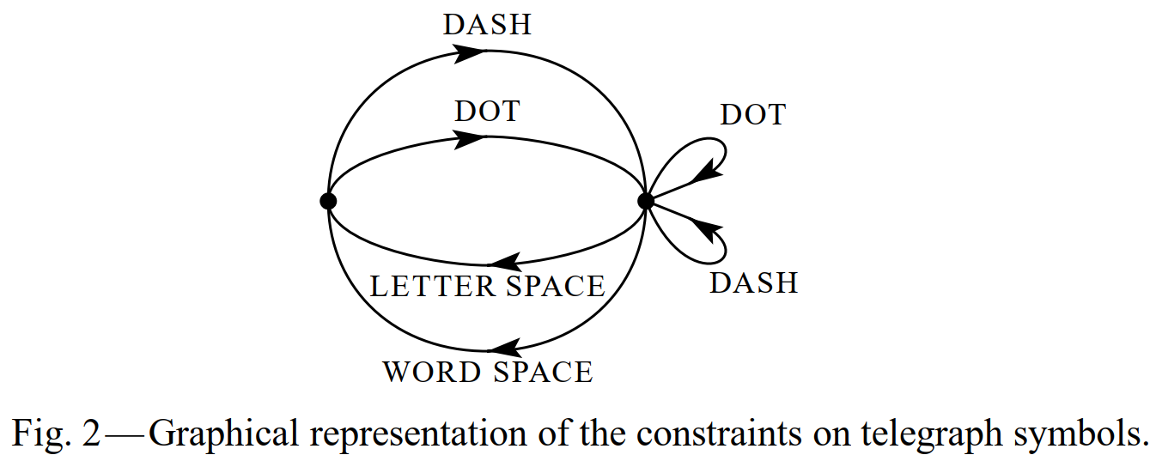

Restrictions to the allowed sequences
Telegraph example:
only certain symbols in certain states
Capacity is obtainable by solving the determinant equation
$$\left| \sum_{s}{W^{−b_{ij}^{s}}−δ_{ij}}\right|= 0$$
$b_{ij}$ duration of action going from state i to j
$δ_{ij}=1 if i=j$
$Capacity=\log{W}$

Slide 9
2 Discrete source of information
How is an information source to be described mathematically?
How much information in bits per second is produced in a given source?
Statistical knowledge about the source -> proper encoding -> reducing capacity of the channel
Discrete Source represented by a stochastic process
Produce discrete sequence of symbols chosen from a finite set

Slide 10
2 Discrete source of information
How is an information source to be described mathematically?
How much information in bits per second is produced in a given source?
Statistical knowledge about the source
proper encoding
reducing capacity of the channel

Slide 11
2 Discrete source of information
Discrete Source represented by a stochastic process
Artificial languages constructed to approximate natural languages
Approximation | Stochastic process
Zero-order | Independent Equal probabilities
First-order | Independent Probabilities from natural language
Second-order | Letter dependent on last letter Table of digram frequencies
Third-order | Letter dependent on last two letters Trigram-structure
Notes:
Produce discrete sequence of symbols chosen from a finite set

Slide 12
3 Series of approximation to English
Approximation | Example for English language
Zero-order | XFOML RXKHRJFFJUJ ZLPWCFWKCYJ FFJEYVKCQSGHYD QPAAMKBZAACIBZLHJQD.
First-order | OCRO HLI RGWR NMIELWIS EU LL NBNESEBYA TH EEI ALHENHTTPA OOBTTVA NAH BRL.
Second-order | ON IE ANTSOUTINYS ARE T INCTORE ST BE S DEAMY ACHIN D ILONASIVE TUCOOWE AT TEASONARE FUSO TIZIN ANDY TOBE SEACE CTISBE.
Third-order | IN NO IST LAT WHEY CRATICT FROURE BIRS GROCID PONDENOME OF DEMONSTURES OF THE REPTAGIN IS REGOACTIONA OF CRE.
First-order word | REPRESENTING AND SPEEDILY IS AN GOOD APT OR COME CAN DIFFERENT NATURAL HERE HE THE A IN CAME THE TO OF TO EXPERT GRAY COME TO FURNISHES THE LINE MESSAGE HAD BE THESE.
Second-order word | THE HEAD AND IN FRONTAL ATTACK ON AN ENGLISH WRITER THAT THE CHARACTER OF THIS POINT IS THEREFORE ANOTHER METHOD FOR THE LETTERS THAT THE TIME OF WHO EVER TOLD THE PROBLEM FOR AN UNEXPECTED.
Notes:
a sufficiently complex stochastic process will give a satisfactory representation of a discrete source

Slide 13
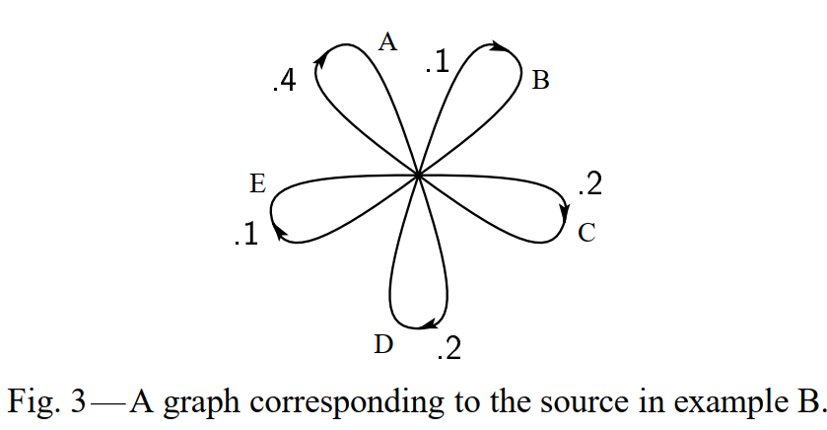
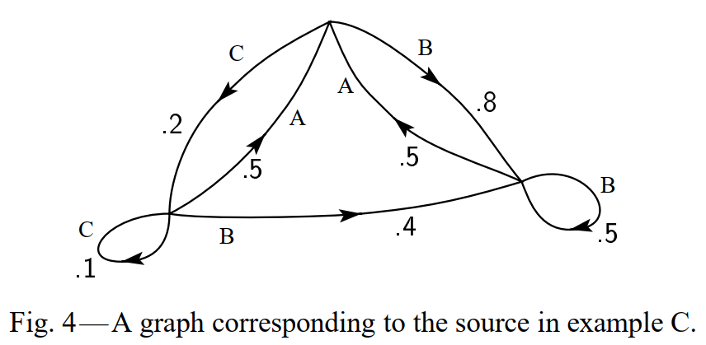
4 Graphical representation of a Markoff Process
Stochastic process can be described as a Markoff process:
Finite number of possible states
Set of transition probabilities

Slide 14
5 Key Points

